Slide 1
Asset Management with Barcode Tagging System for Operations and Maintenance
Miguel Jaime Mayor
Joanna De Guzman
Adrian Tobias

Slide 2
Introduction:
Our Goal
Create an application
Our Client
Weather.ph
Our Application
What does it do?

Slide 3
Project Context
Operations and Maintenance
Weather stations
Problem
Handles Weather Stations
More than a thousand units
Data Management
Fixes weather station problems
All over the regions of the Philippines

Slide 4
Purpose and Description
To arrange and manage data
To improve access of data
WAMS
To increase reliability against errors

Slide 5
Objectives:
Algorithm
Better and faster
Minimize delay
Proposal
Usable methods
Solve the problem
Software Solution
Solves inefficiency to increase work outputs

Slide 6

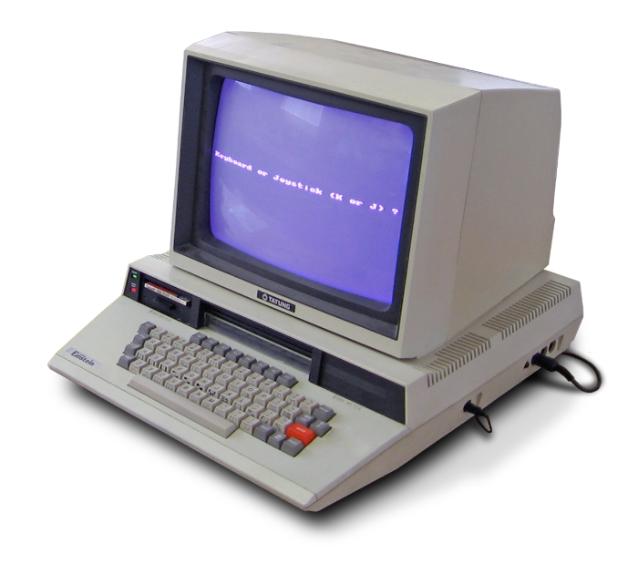
Scope and Limitations:
Improvement of the old system

Slide 7



Scope and Limitations:
Accessible by registered users

Slide 8



Scope and Limitations:
Will not cover other departments

Slide 9







Scope and Limitations:
Does not cover any other problems

Slide 10


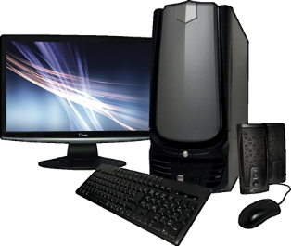

Technical Background:

Slide 11
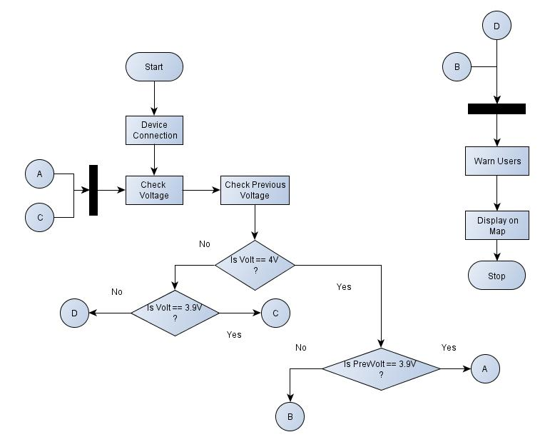
Design and Methodology
Battery Life
Checking

Slide 12
Results and Discussion
Service Report
CRUD Functionality
Event
Scheduling
Event view
Algorithm
Has not yet been applied
Continuation of the system

Slide 13
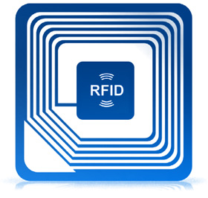



Review of Related Literature
RFID vs. Barcode
RFID VS BARCODES: Advantages and disadvantages comparison. Adaptalift

Slide 14

Review of Related Literature
Preventive Maintenance
Preventive maintenance of medical equipment in Alzahra Hospital, Isfahan, Iran 2013

Slide 15
DEMO PROTOTYPE
DEMO PROTOTYPE
DEMO PROTOTYPE

Slide 16
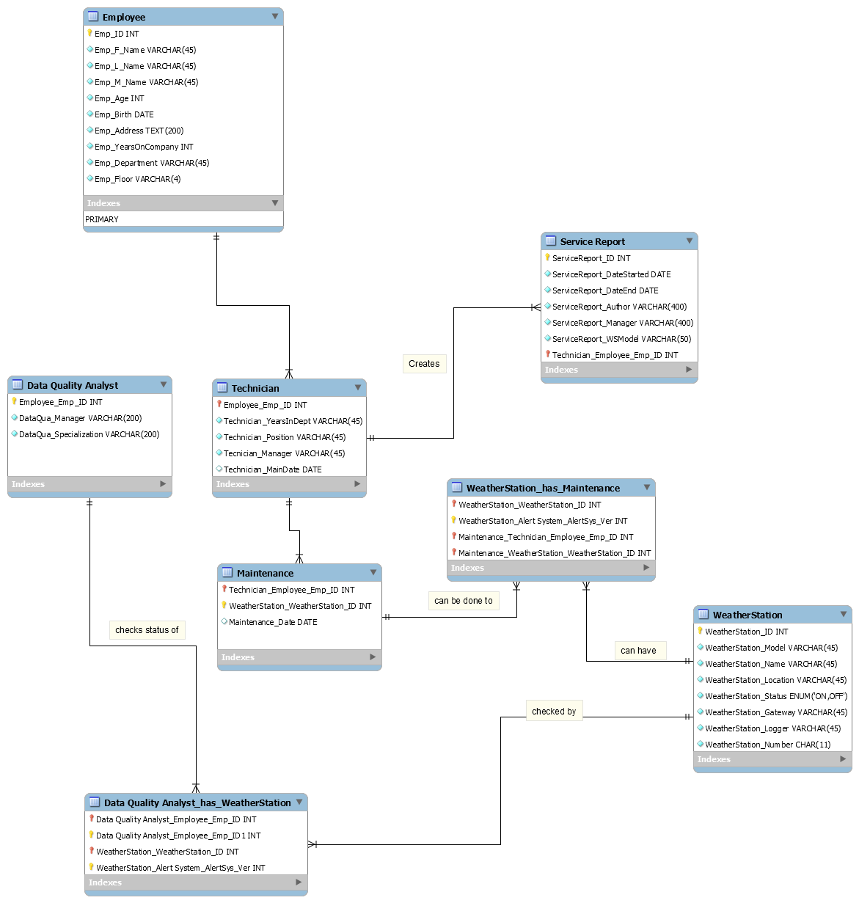
ERD
Is

Slide 17
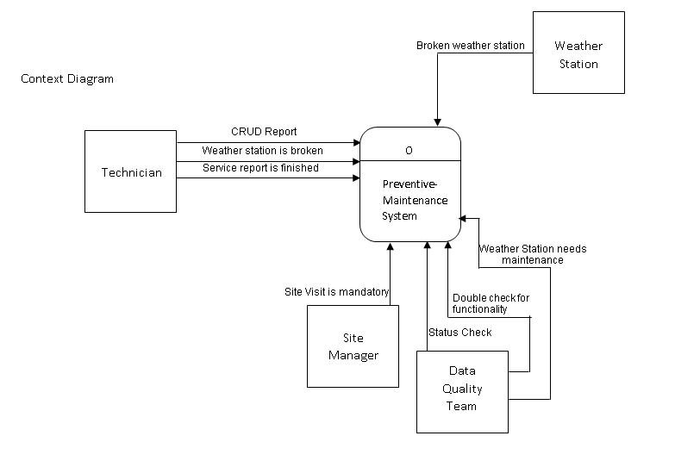
CONTEXT

Slide 18
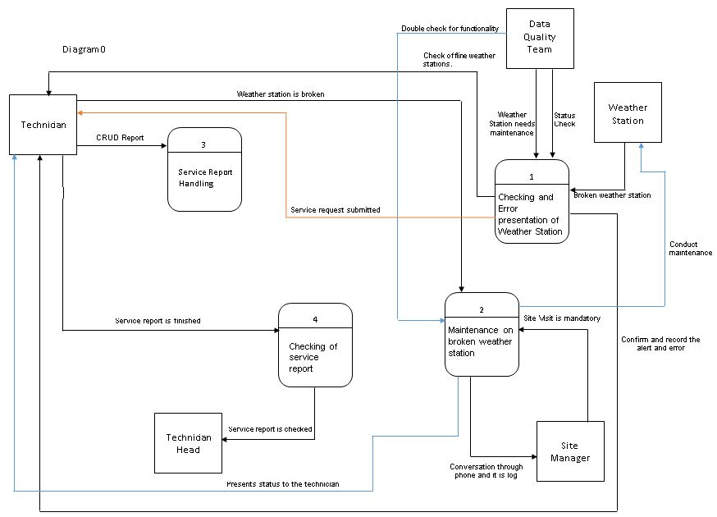
CONTEXT

Slide 19
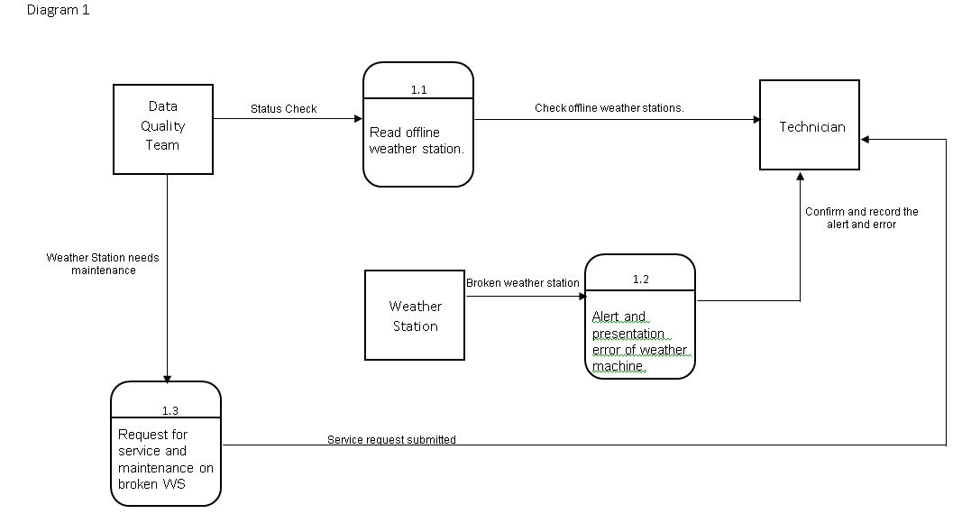

Slide 20
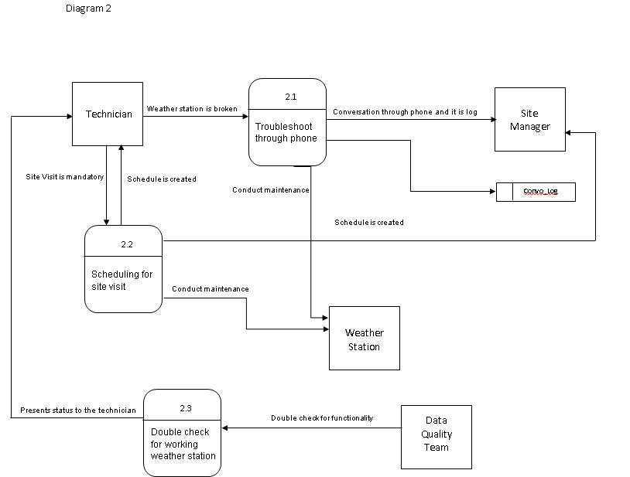

Slide 21
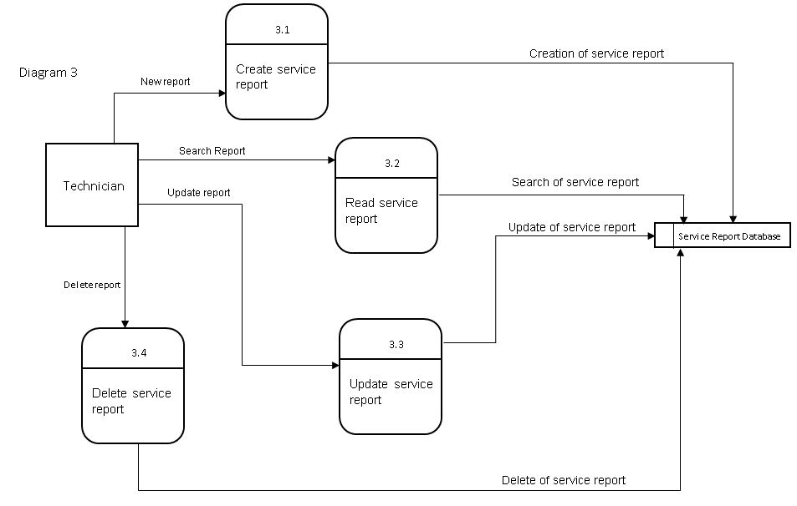

Slide 22
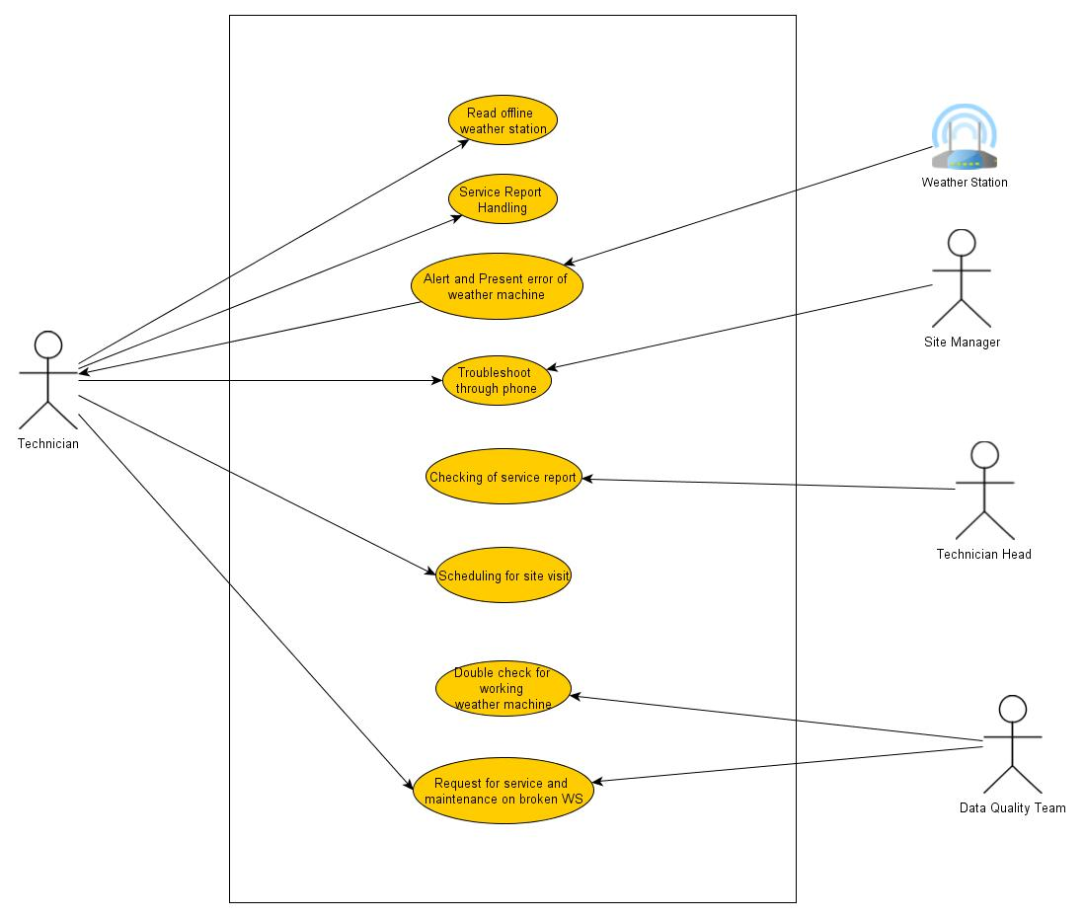
USE CASE

Slide 23
Conclusion and Recommendation
Battery Check-up
Digital Signing
Preventive Maintenance
Weather Station Map

